Slide 1
Probabilistic Finite-State Chatbot: Combining Stochastic Automata and Language Processing
Authors:
Dean Worrels
Timon Stacy
Roy Ibarra
April 24, 2025

Slide 2
What is the Assignment?
Our task was to design and implement a working system that demonstrated finite-state behavior. We decided to design a chatbot using C++ which focuses on assisting users with shipping and ordered related queries, similar to support systems seen in the ecommerce world such as Amazon.

Slide 3
Project Background
Most chatbots rely on finite state machines, in which user input triggers a predetermined response. This often leads to unnatural and robotic like responses. Our goal was to build a chatbot that goes beyond this limitation using probabilistic automata. With randomized state transitions between each response, to mimic natural human conversation.

Slide 4
Main Objectives
Develop a finite-state structure in C++ using a binary search tree of state nodes
Allow users to navigate through conversations using keywords mentioned in phrases.
Generate multiple predefined responses for each recognized keyword state and selecting one randomly during each interaction

Slide 5
User Interaction
Users are asked to enter a statement. If a keyword is found, the system navigates to the relevant state and select one of the three predefined responses at random. If no keyword is found, the chatbot provides a fallback message to the user to rephrase their initial response. The interaction continues until the user exits.

Slide 6
Questions the user can ask
Because our chatbot is designed with a specific use case in mind being customer service interaction in the context of ecommerce.
Example questions include:
“Where is my order?”
“What is my order number?”
“Update on my order?”

Slide 7
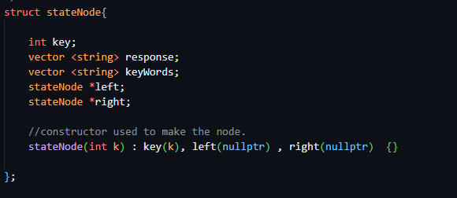
How the states are constructed
For the code implementation we used a BST (easy to add the States / nodes) . Each state has a vector that stores specific responses and keywords. These responses can be seen as other states and the keywords are what tells the program what state to go to.

Slide 8
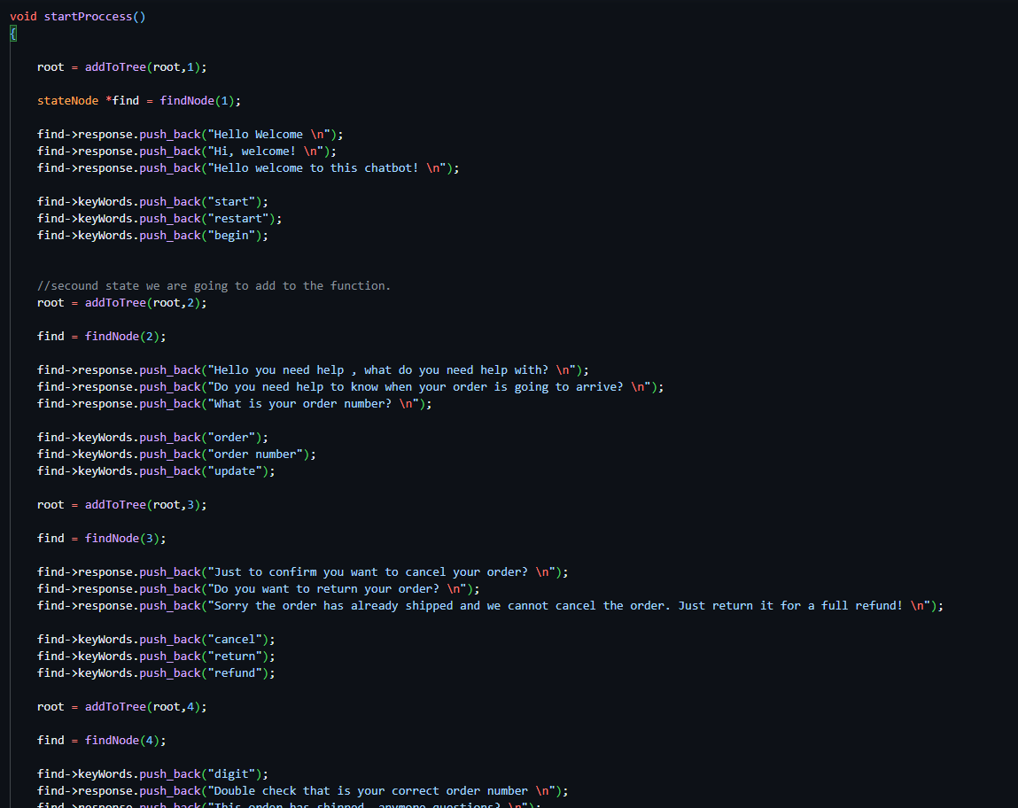
Code Implementation
We “hard coded” the actual states.
For each state they had at most 3 different keywords and exactly 3 different responses.

Slide 9
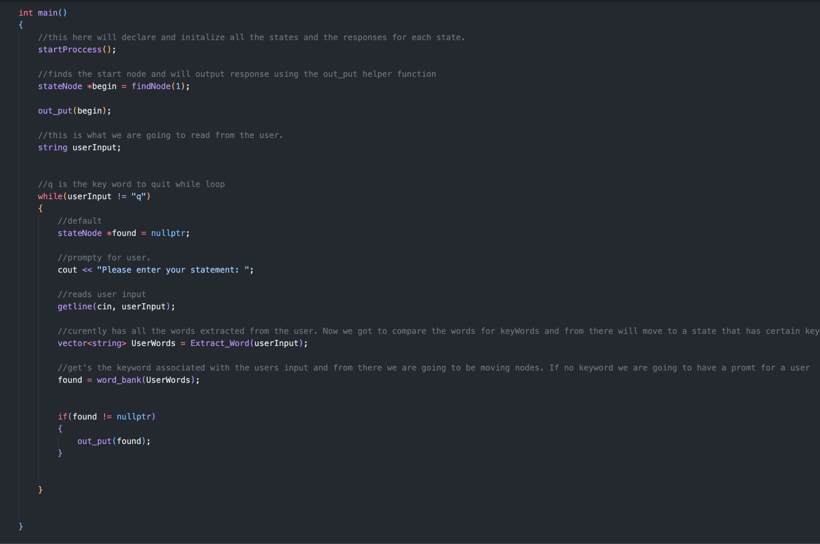
How the main function looks
To start off we go to the start state and out put a randomly generated response from there . After that we finally prompt the user to input a statement. We read the statement and extract all the words from it and store it into a vector named “UserWords”. From their we use one more function to look at the vector containing all the words.

Slide 10
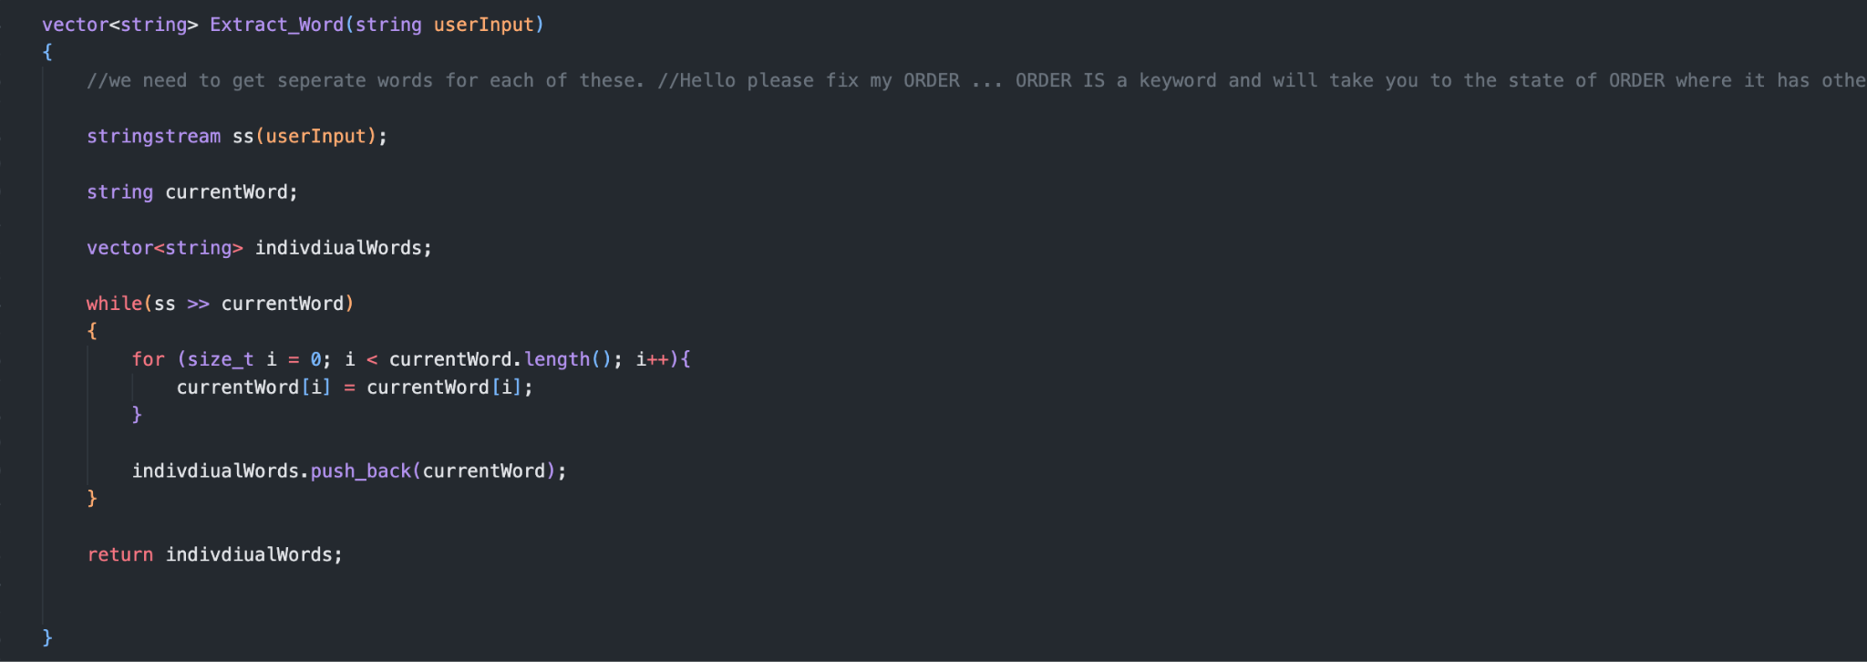
Inside Extract_Word function
Uses String stream to store each individual word into currentWord and push it back into the vector. Returned the vector with all the strings / words in it.

Slide 11
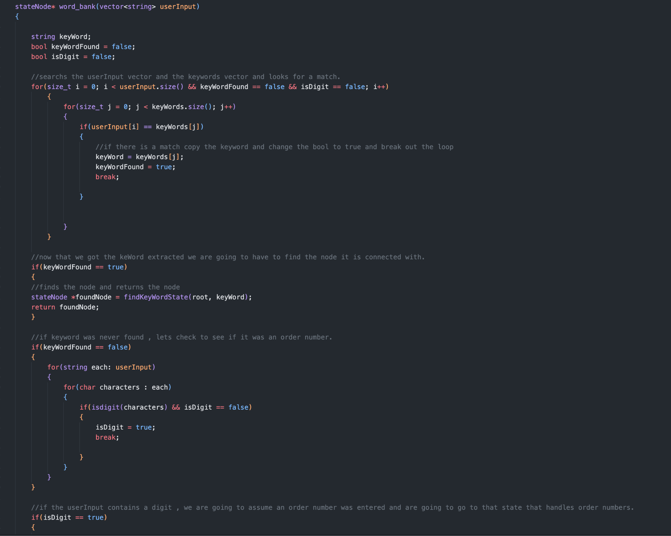
Inside word_bank function
This function compares the users input which is now a vector with the vector that stores all the keywords. If there is a match we use the function findKeyWordState to locate the state with the keyword and then return the state back to the main function. We also have code to help determine if what the user inputed was an order number which could not fit on the screen and a default case, if what the user inputed didn’t match a keyword.

Slide 12
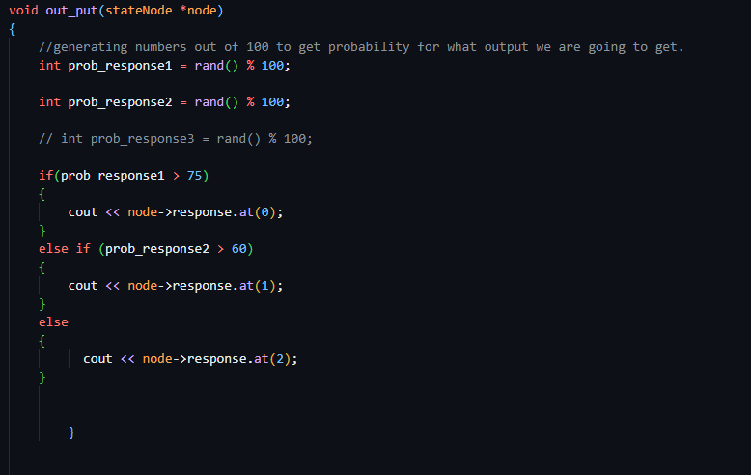
How does it generate random probabilities?
Given this code here. The keyword we picked up from the user input leads us to the state/node that represents the keyword. We then use this as the argument in the function. Each state has 3 more possible states (responses) it can lead to which are going to be the the responses . We never know which response will output due to the rand() function.

Slide 13
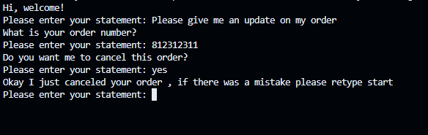
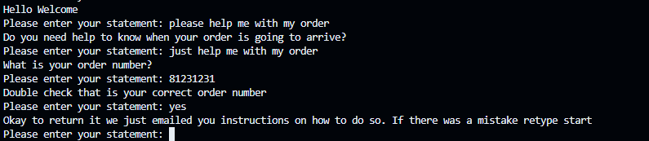
Code execution
As you can see each state will generate different outputs randomly through the STL function rand().

Slide 14
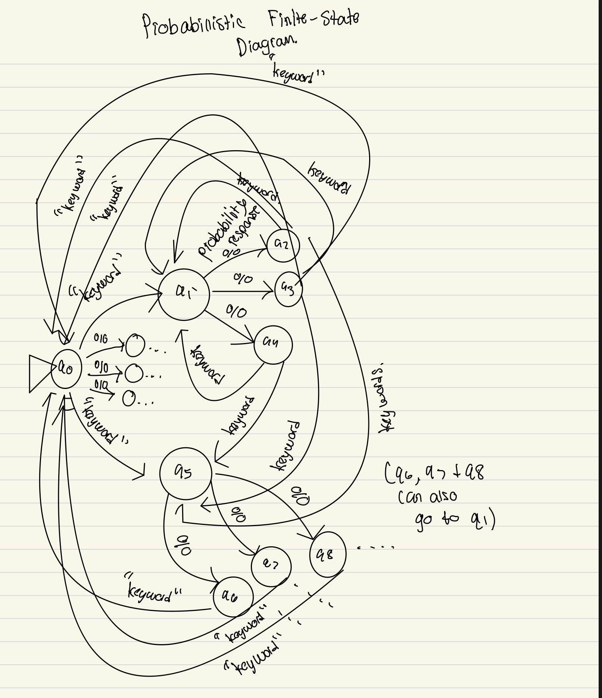
Diagram on the code
This diagram only shows 3 keyword states and each keyword state has 3 output states. For the actual program there are more states. This is to help see what is going on behind the scenes.

Slide 15
Evaluation Methods
Monte Carlo Simulation:
Executes the chatbot’s out_put() logic millions of times
Records how often each canned reply is chosen under the current random thresholds
Deterministic Mode (Probabilities Removed):
Always selects the first response for a given set of keywords
Guarantees one fixed reply per input—no randomness involved
Simplifies debugging and provides a clear baseline for comparison
Lacks variability, so it doesn’t reflect realistic user–bot interactions

Slide 16
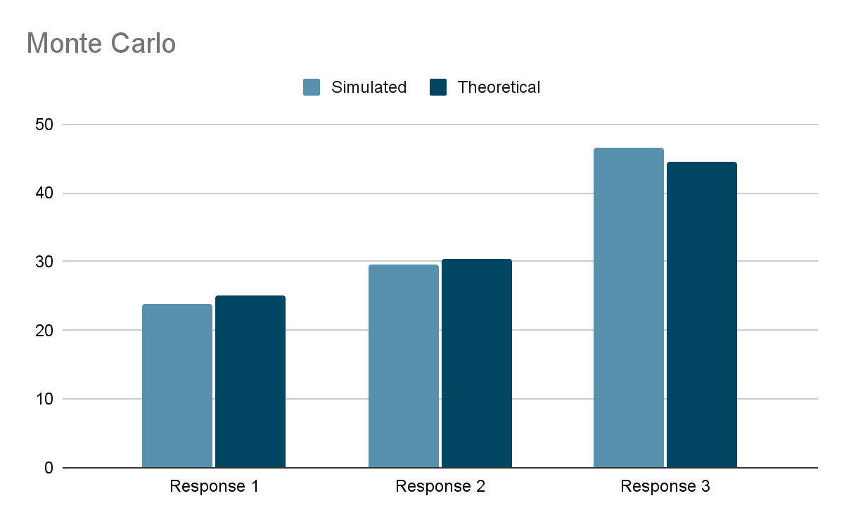
Monte Carlo

Slide 17
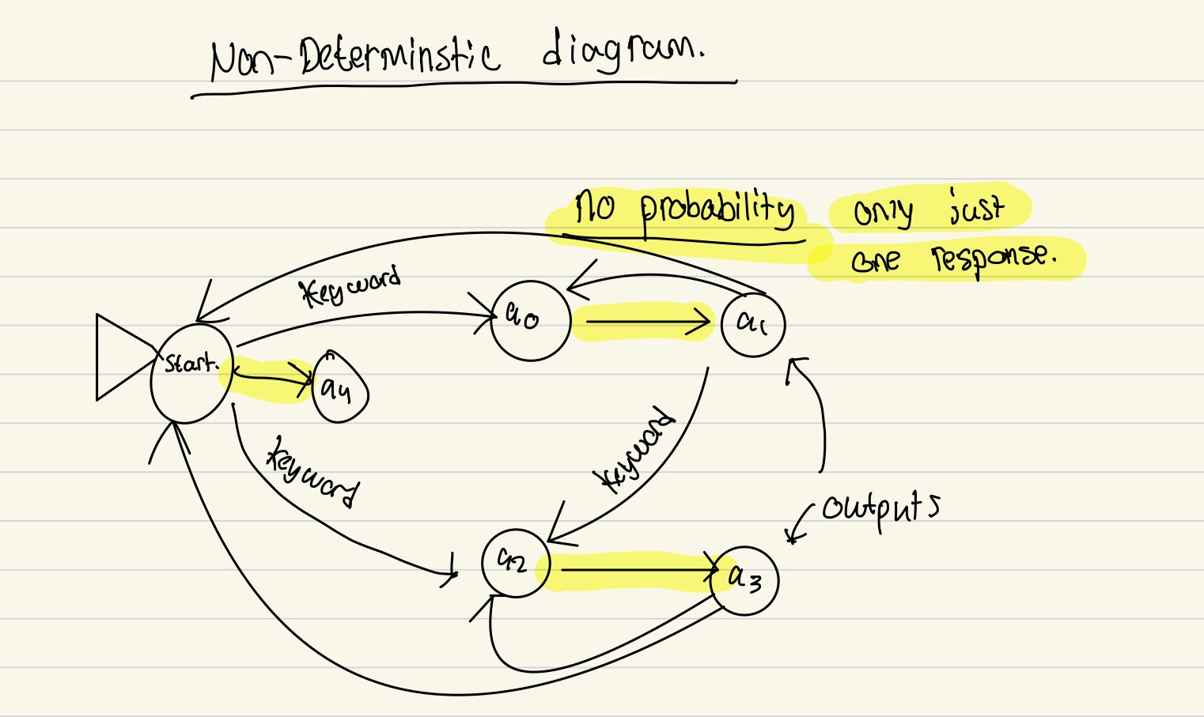

Slide 18
Probabilistic vs Deterministic Chatbots
void out_put(stateNode *node)
{
int prob_response1 = rand() % 100;
int prob_response2 = rand() % 100;
// int prob_response3 = rand() % 100;
if(prob_response1 > 75){cout << node->response.at(0);}
else if (prob_response2 > 60){cout << node->response.at(1);}
else{cout << node->response.at(2);}
}
cout << node->response.at(0);

Slide 19
Probabilistic vs Deterministic Chatbots
Probabilistic output: ”Hello Welcome"
“Hi, welcome!”
“Hello welcome to this chatbot!”
Deterministic output: “Hello Welcome”

Slide 20
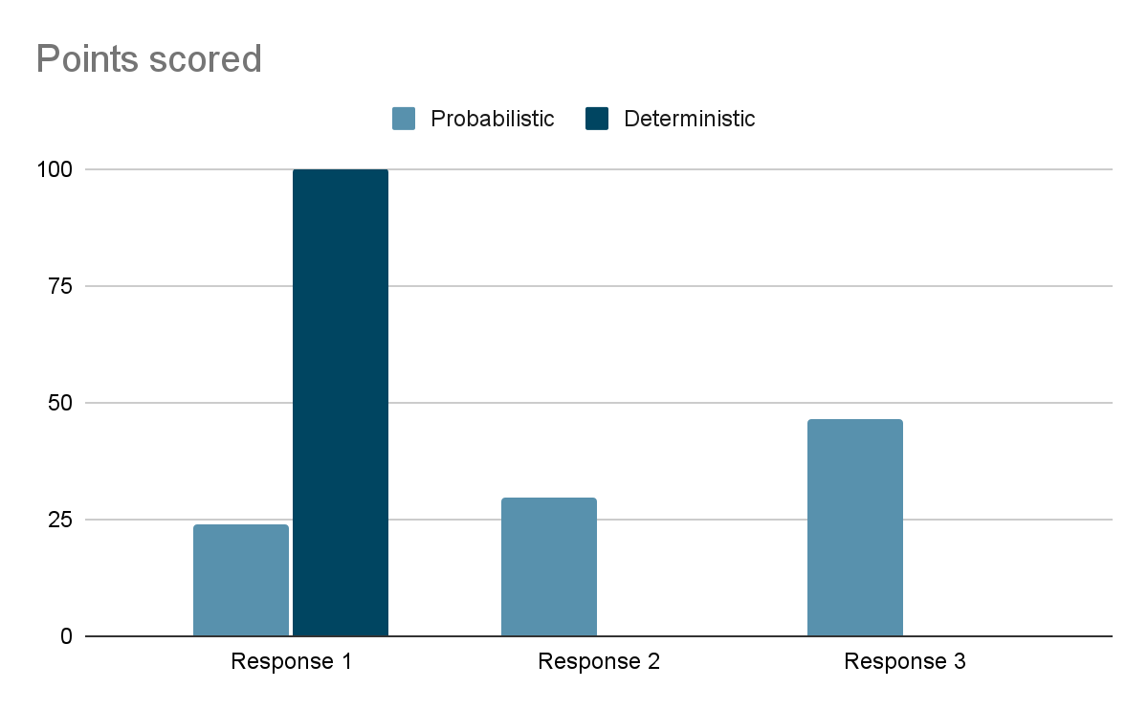

Slide 21
Results
Achievements:
• Implemented a C++ finite-state chatbot with probabilistic response selection
• Supported multiple, varied replies per keyword-driven state
Validation:
• Monte Carlo simulation confirmed empirical response frequencies align with theoretical thresholds
• Deterministic baseline comparison highlighted the benefits of controlled variability
Key Takeaways:
• Probabilistic automata introduce natural conversational variation vs. rigid FSMs
• Threshold tuning lets us easily rebalance reply distributions to suit different UX goals

Slide 22
Thank you!
ANY QUESTIONS?

